Slide 1
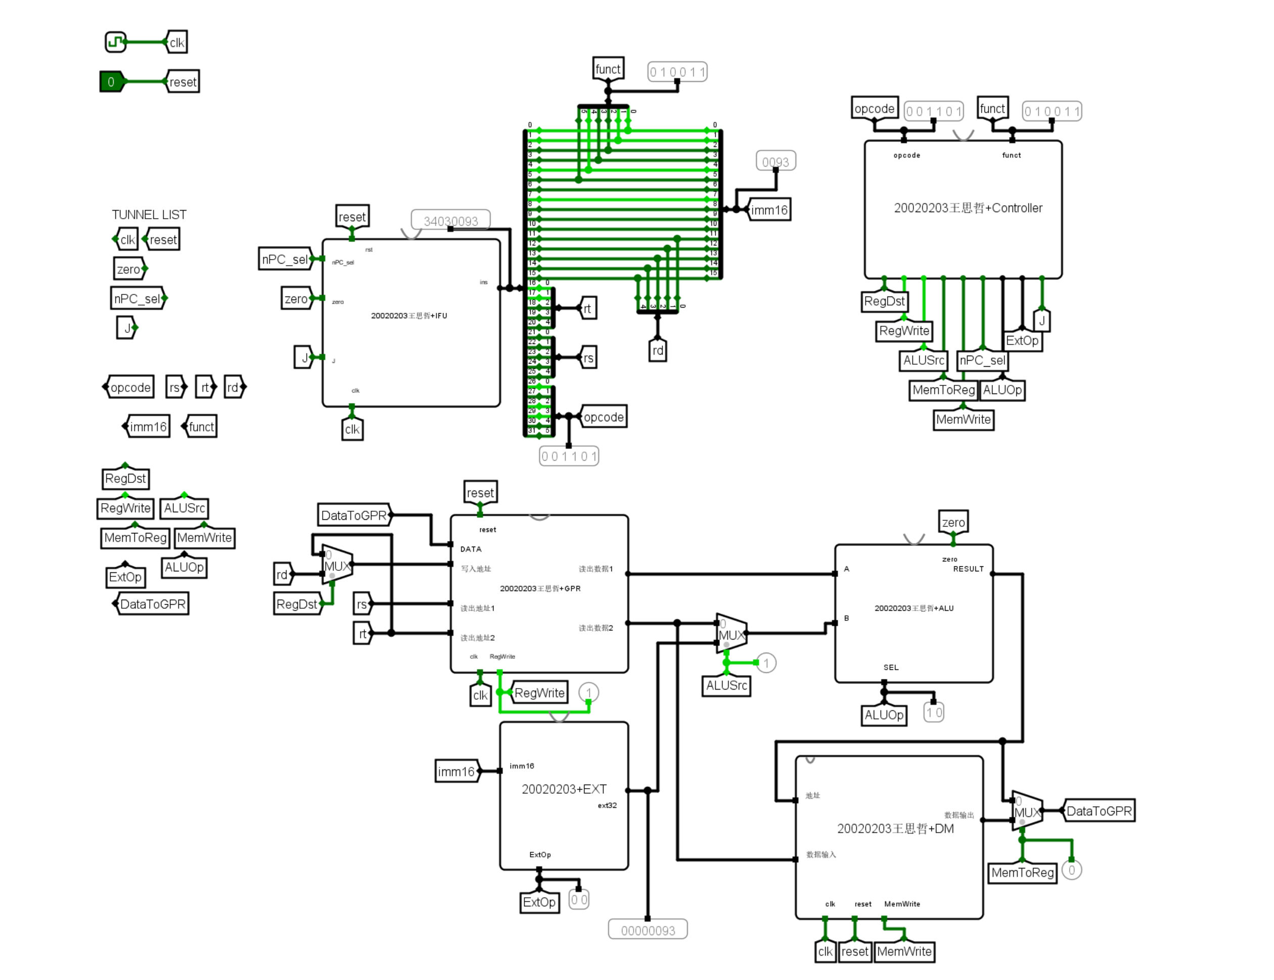
overflow
condition
Jr_ctrl
Jr_ctrl
BGEZAL
write30
Jr_addr
JALaddr
write31
pc+8
pc+8
JALaddr
condition
overflow
Jr_addr
write30
BGEZAL
write31

